Slide 1

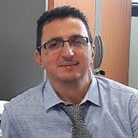
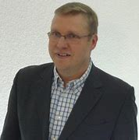
Colloque
16 Septembre 2021
Approches Innovantes dans la lutte contre l’antibiorésistance
Prof. Djamel Drider
Université de Lille
Dr. Philippe Gabant
Co-founder & CSO
Syngulon SA, Seraing (Belgique)

Slide 2
Les peptides antimicrobiens : pourquoi et comment ?
Les bactériocines
Plan de la présentation
- Eléments généraux sur les bactériocines (D3-D10).
- Partie D. Drider, Université de Lille (D11-D19).
- Partie P. Gabant, Syngulon SA, Seraing, Belgique. D20-D34

Slide 3
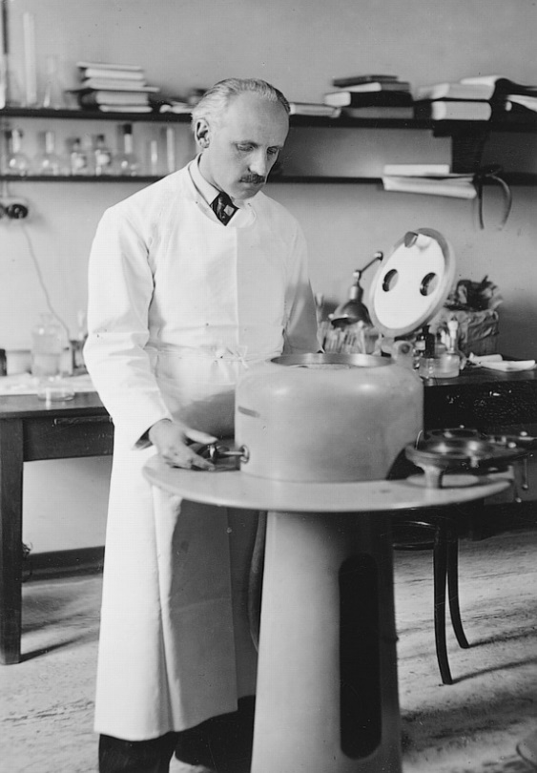


Bacteriocins
1925 (colicin)
Prof. André GRATIA (1893-1950)
Prof at ULB and later at ULiège

Slide 4

Bacteriocins are Antimicrobial Peptides (AMPs) :
- ribosomally synthesized by Gram-positive, Gram-negative and Archaea
- scheme of production of primary metabolites
- proteinaceous nature
- non-cytotoxic (usually)
- active against bacteria which are phylogenetically close to the producing strains but…
- stable at different pHs and temperatures
- no universal classification common scheme

Slide 5

Data and database (s)
4.35%
APD3. http://aps.unmc.edu/AP (2016)
OCINS. http://ocins.cftri.com/ocins/ (2019)
BACTIBASE. bactibase.hammamilab.org/main.php (2010 updated)

Slide 6
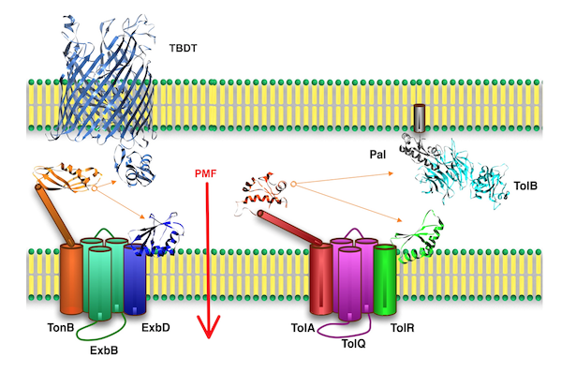
  Mode of action of colicin-like bacteriocins
Image: LISM - CNRS (cnrs-mrs.fr)
The therapeutic potential of bacteriocins as protein Antibiotics by Hannah M. Behrens et al. 2017. Emerging Topics in Life Sciences (2017) 1 65–74

Slide 7
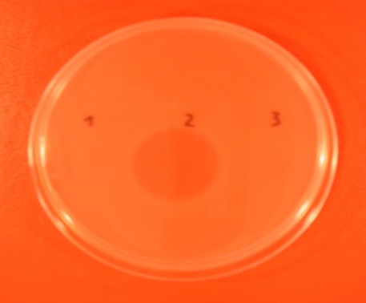
  Mode of action of LAB-bacteriocins
  Gram-positive bacteria
Pore forming
Cell – membrane target
µM CONCENTRATION
nM CONCENTRATION
7
7

Slide 8
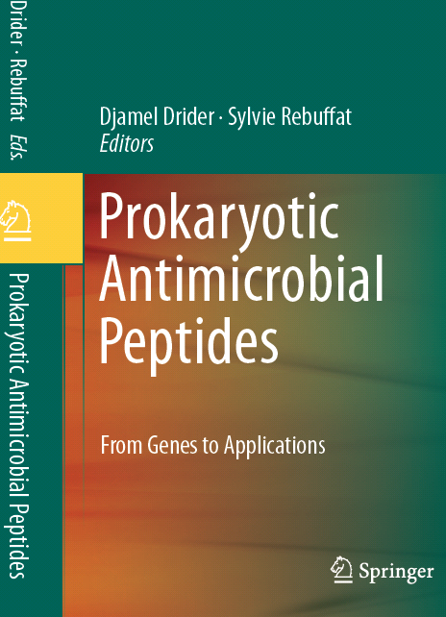
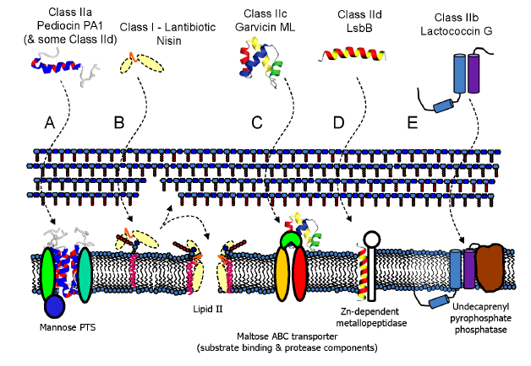
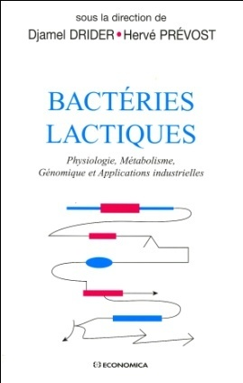
  Docking molecules of LAB-Bacteriocins
COTTER et al. (2013). Nature Reviews Microbiology. 11: 95-105
RseP likely serves as the receptor for EntK1 and EntEJ97: stress response membrane-bound Zn dependent protease
8

Slide 9
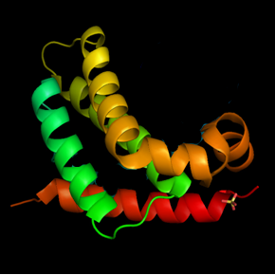
Portal functions of bacteriocins
Portal functions of bacteriocins
Antiviral Agents
Antiviral Agents
Synergistic Agents
Synergistic Agents
Microbiota Regulators Agents
Microbiota Regulators Agents
Anticancer Agents
Anticancer Agents
Plants Growth Promotors
Plants Growth Promotors
Food additives
Food additives

Slide 10
Portal functions of bacteriocins
Antiviral Agents
Synergistic Agents
Microbiota Regulators Agents
Anticancer Agents
Plants Growth Promotors
Food additives

Slide 11
LAB-BACTERIOCINS – Prof. D. Drider
  Nisin (Nisaplin)
  Nisin/colistin combination
  Divercin V41
  Class IIa
  Carnobacterium divergens V41
  Enterocin DD14
  Leaderless class IIb
  Enterococcus faecalis 14
  E20 fraction
  5 novel class II LAB-bacteriocins
  Activity against Escherichia coli (E. coli mcr-1)
  EP 19178926.2

Slide 12
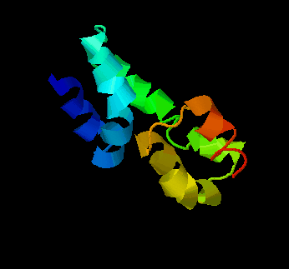

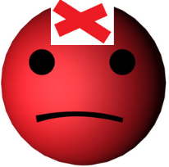
Spectrum of Leaderless class II b Enterocin DD14
Methicillin Resistant Staphylococcus aureus
Listeria monocytogenes
Clostridium perfringens
Staphylococcus aureus
Enterococcus faecalis V583
(VRE)

Slide 13
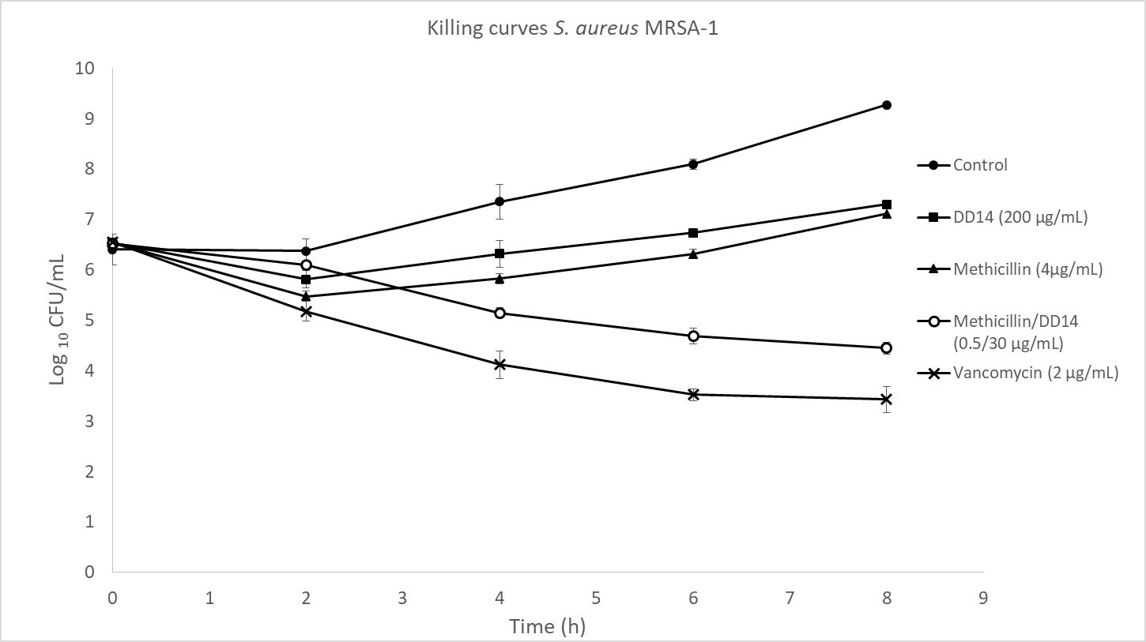
Anti-MRSA activity (MRSA-S1)
FICI values
Killing curves
Control
Strains | DD14 (µg/mL) | Methicillin (µg/mL) | Met/DD14 (µg/mL)
S. aureus S1 (MRSA) | >200 | 4 | 0.5/30
S. aureus USA300 (MRSA) | >200 | 16 | 4/30
S. aureus ATCC 25923 (MSSA) | >200 | 0.5 | 0.25/30
DD14
Methicillin
Methicillin / DD14
vancomycin
Please remember MRSA-S1 is resistant to Erythromcin & DD14 + Erythromycin have a synergistic interaction

Slide 14
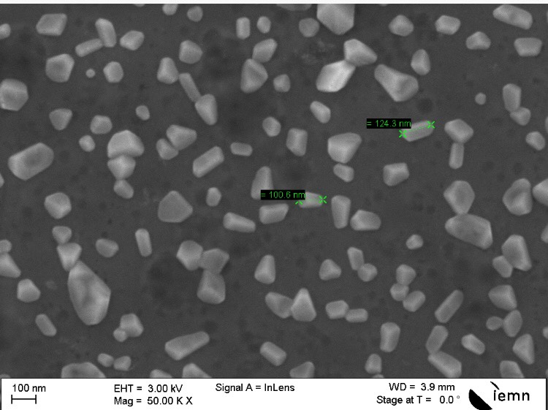
Development of nanobiotics anti-MRSA-S1
Alginate nanoparticles
EntDD14 + Alginate nanoparticles = Nanobiotics
MIC Ent DD14 : 240 µg/ml
MIC Ent DD14 + Alginate nanoparticules = 60 µg/ml
(EntDD14 + Alginate Nanoparticles) + methicillin,
MIC methicillin 4 à 0.25 µg/ml

Slide 15
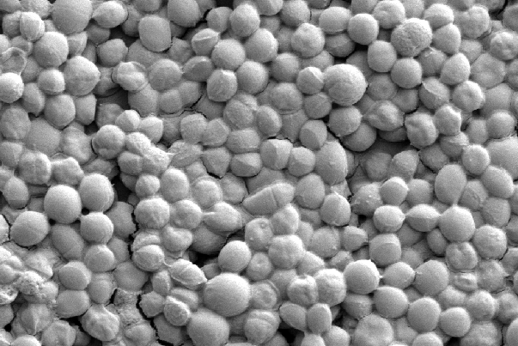
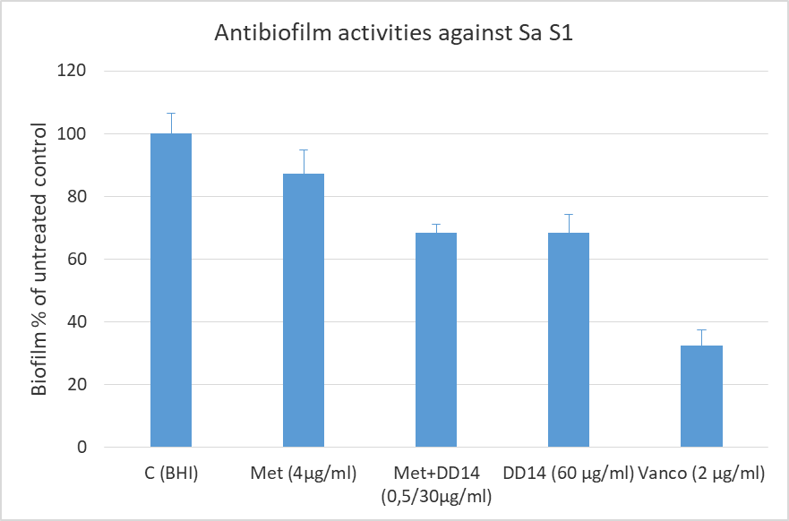
Anti-biofilm activity
SEM MRSA-S1 biofilm on glass slides
Biofilm: Cristal violet method on polyester plates

Slide 16
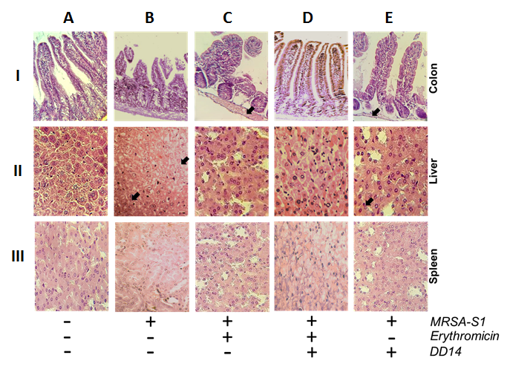
Histological alterations following SARM infections, Erythromycin and/or DD14 treatments

Slide 17
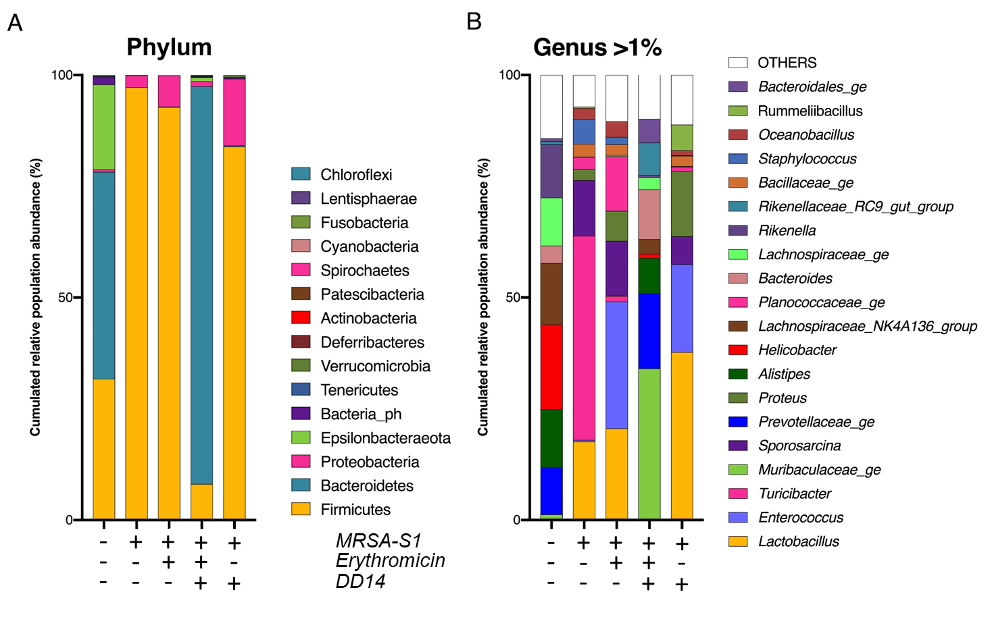
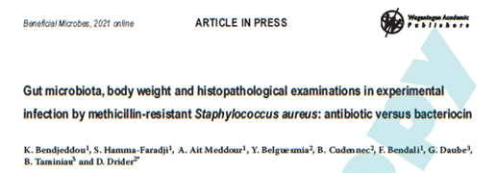
Histological alterations following SARM infections, Erythromycin and/or DD14 treatments
Body weight evolution (statistic analysis)

Slide 18
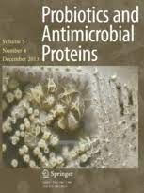
Innovative strategy
Gut microbiota is an important source of bacteriocins and their in-situ expression can be explored for treatment of bacterial infections
Djamel DRIDER
Probiotics and Antimicrobial Proteins (Review in press)
DOI. 10.1007/s12602-021-09843-y

Slide 19
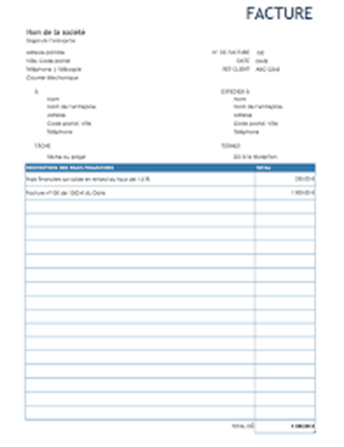
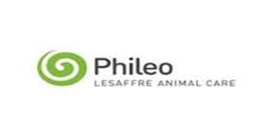


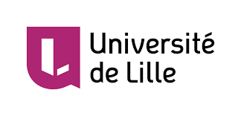
Financial supports and grants
PHILEO
Lesaffre International
ANR
French Agency for Research
La Région des Hauts de France
Local authorities
Lille University

Slide 20
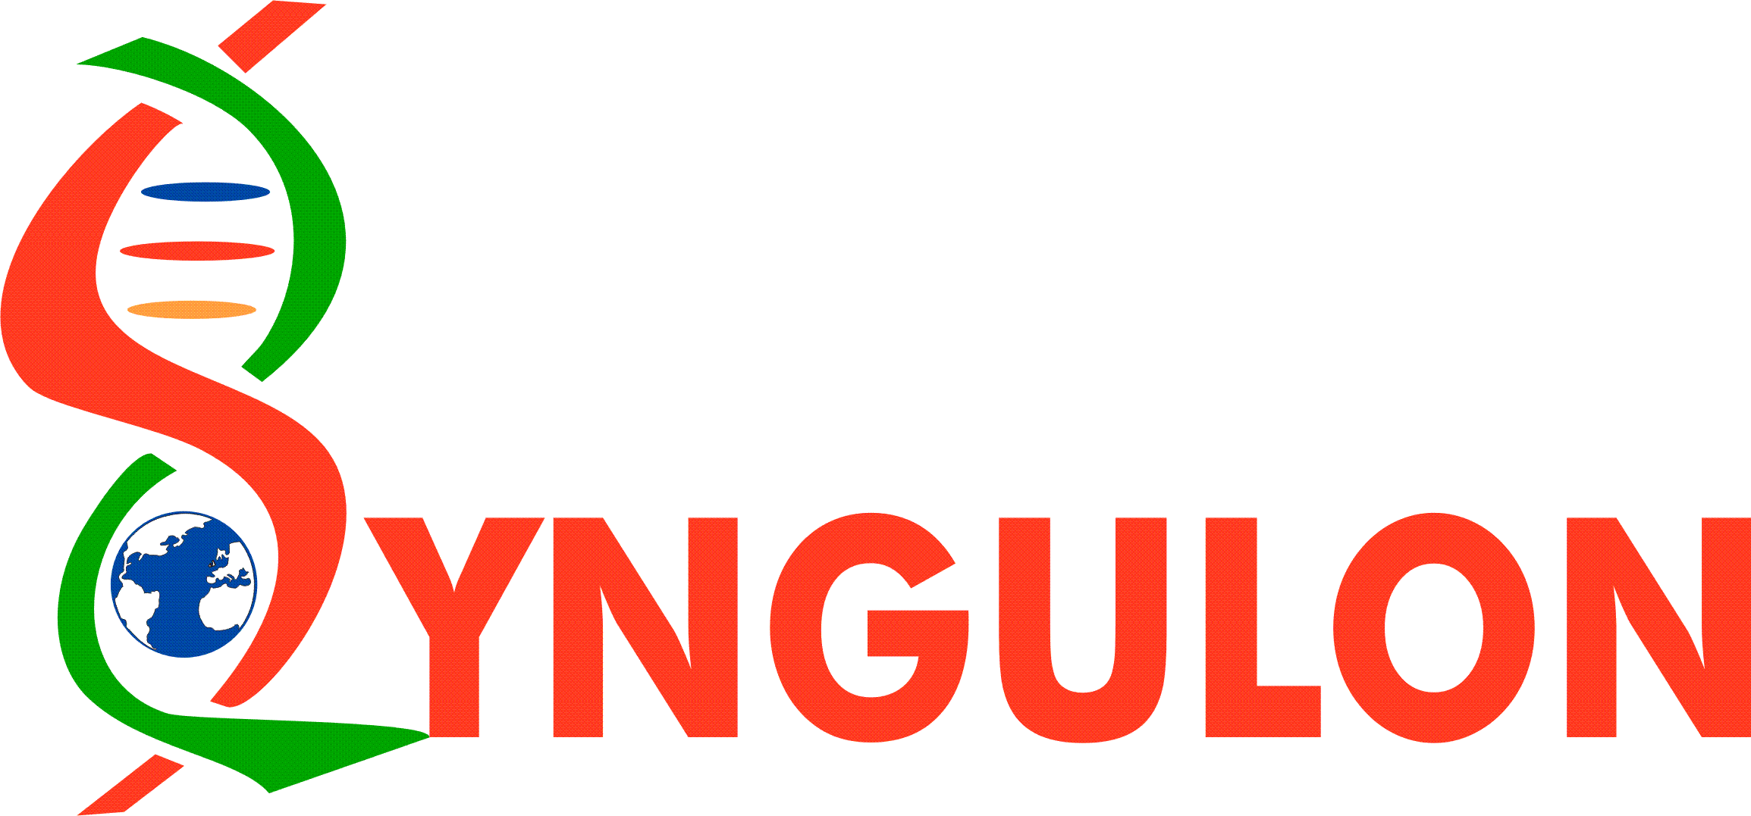


Colloque
16 Septembre 2021 (Paris)
Approches Innovantes dans la lutte contre l’antibiorésistance
Dr Philippe Gabant
Co-fondateur & CSO
pgabant@syngulon.com

Slide 21
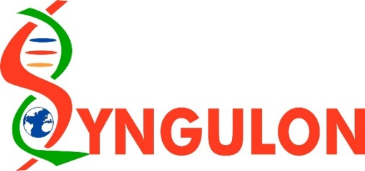
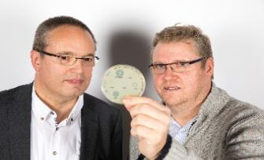

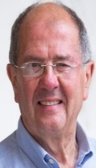
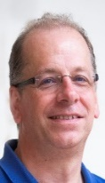









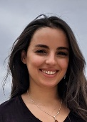
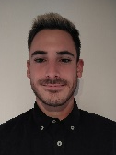
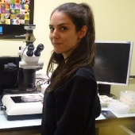
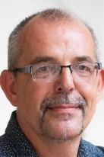
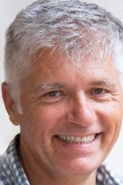
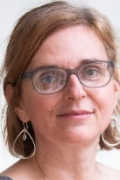
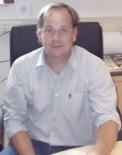

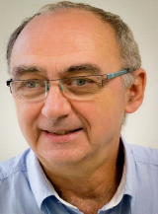







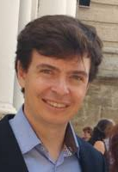
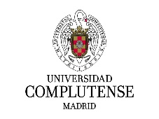




TEAM / SAB / R&D Partners
Scientific Advisory Board
Pr Joseph Martial (Chairman), ULg, Liège (BE)
Pr Bruno André, ULB, Brussels (BE)
Adj-Pr Mike Chandler, University of Georgetown (USA)
Pr Pascal Hols, UCL, Louvain-la-Neuve (BE)
Pr Didier Mazel, Institut Pasteur, Paris (FR)
Pr Laurence Van Melderen, ULB, Charleroi (BE)
Pr Ruddy Wattiez, UMons, Mons (BE)
IN MEMORIAM
Dr Régis Sodoyer, ex-Sanofi Pasteur, Lyon (FR)
Team
Guy Hélin, Co-founder, CEO
Dr. Philippe Gabant, Co-Founder, CSO
Dr. Mohamed El Bakkoury, CTO Yeast
Dr. Jason Bland, R&D Project Manager
Dr. Luz Perez, R&D Project Manager
Dr. Baptiste Dumont, R&D Project Manager
Félix Jaumaux, PhD Student
Dr. Anandi Martin, Senior Project Manager - Infectious Disease
Hajar Amraoui, PhD Student
Loïc Mues, R&D Scientist
Dr. Silvia Soto Diaz, R&D Project Manager
R&D Partners
Collaboration with:
Universidad Complutense Madrid (UCM)
Dr. Juan Borrero

Slide 22


The importance of microbes for life on our planet
Microbes are the chemical biocatalysers of our ecosystem
Microbes are collaborating and fighting with each other to reach certain equilibrium to form communities: « microbiota »
These microbiota have evolved to generate unique chemical reactions via species synergies

Slide 23
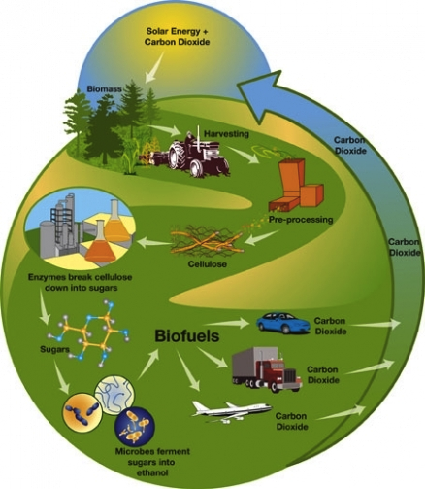
A Biobased Chemistry
Improvements in energy storage
An intensification of biotechnological processes

Slide 24
Bacteria and our health

Slide 25
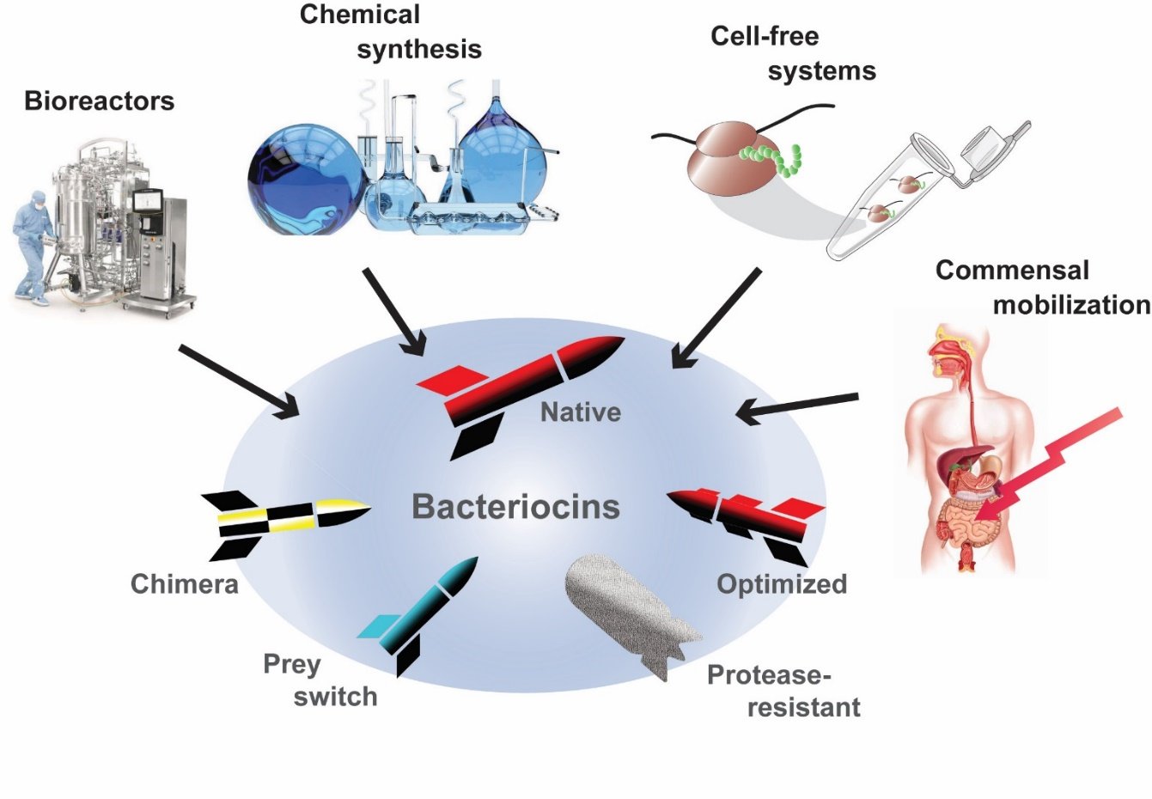
Bacteriocin potential
Production
Genetic amenability
Various prey spectrum
Molecular diversity
Cyto-friendly
Stability
Biological half-life
1925
Pascal Hols, Laura Ledesma-García, Philippe Gabant and Johann Mignolet, Trends Microbiology 1685 No. of Pages 13

Slide 26
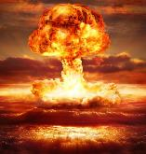
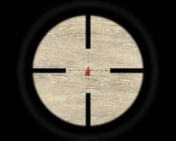
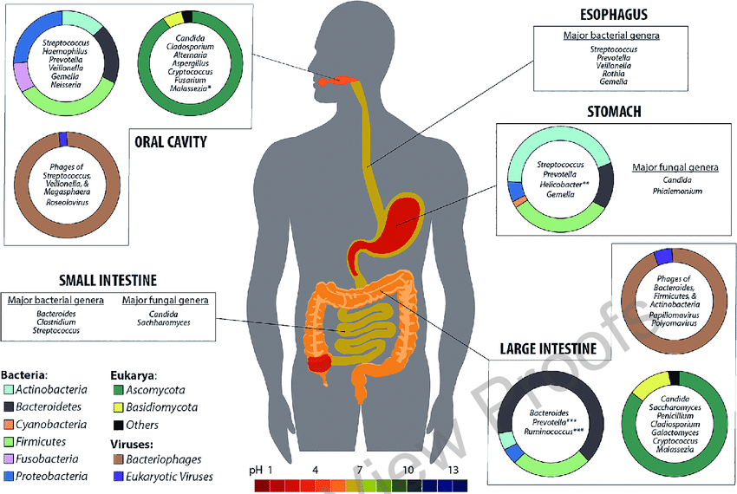
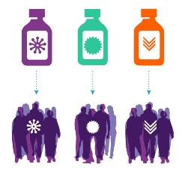
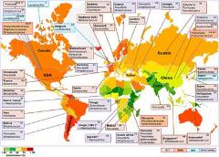
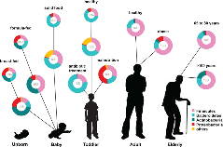
Bacteriocins as alternative to antibiotics
Broad spectrum antibiotics
VS
Narrow spectrum bacteriocins
Human microbiota is very variable
PRECISION MEDICINE

Slide 27
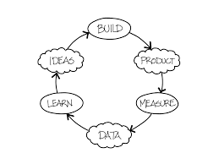
Evolution diversity of bacteriocins

Slide 28
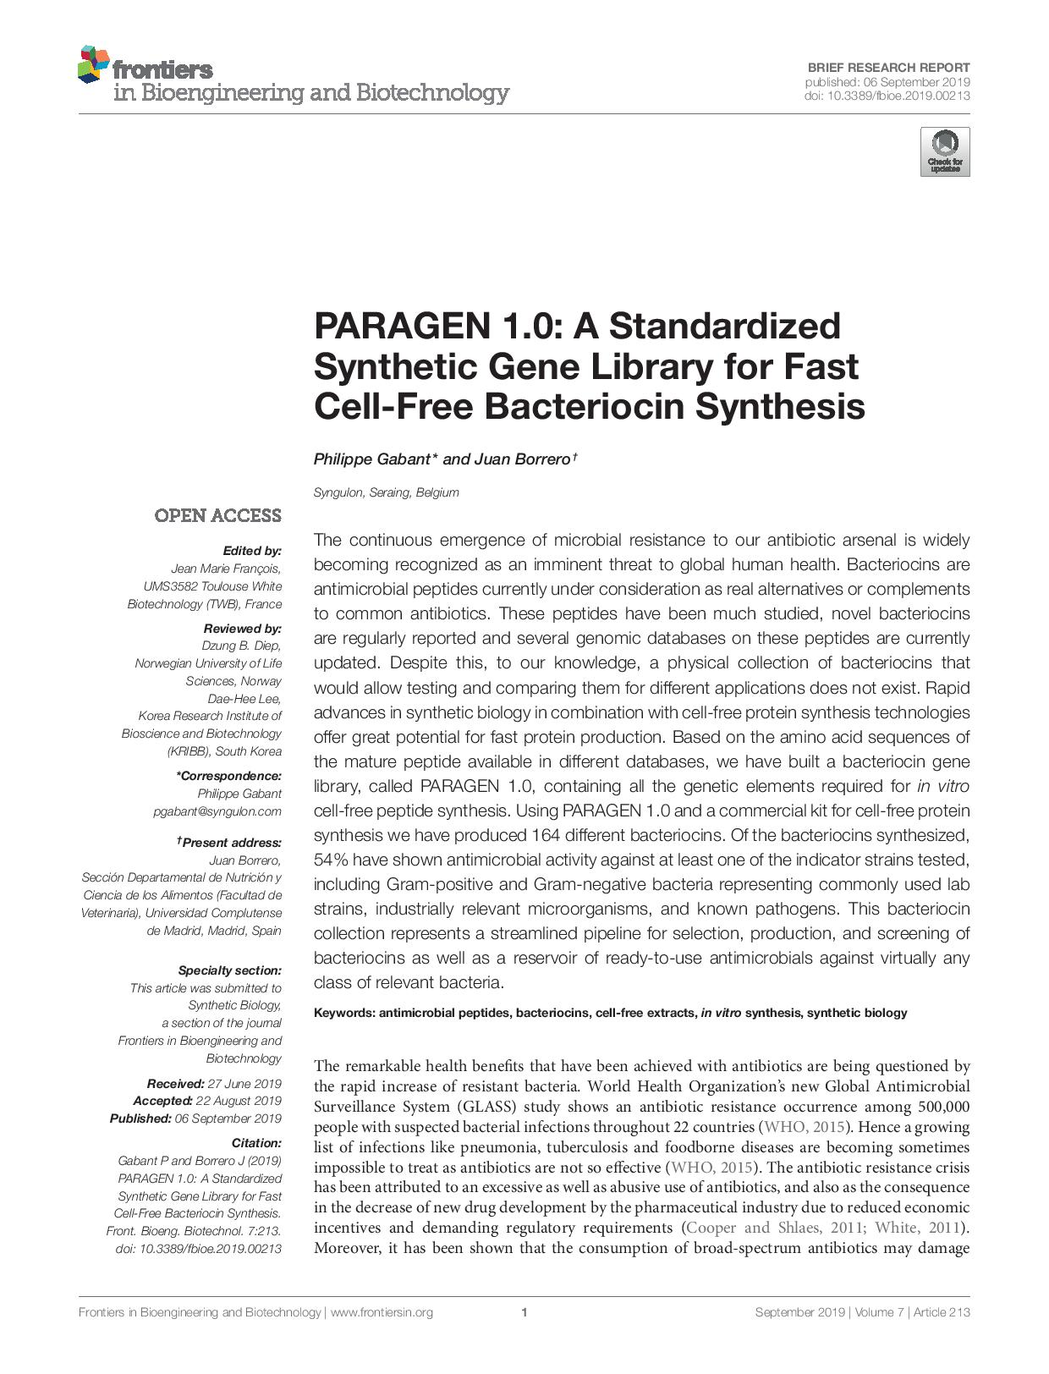
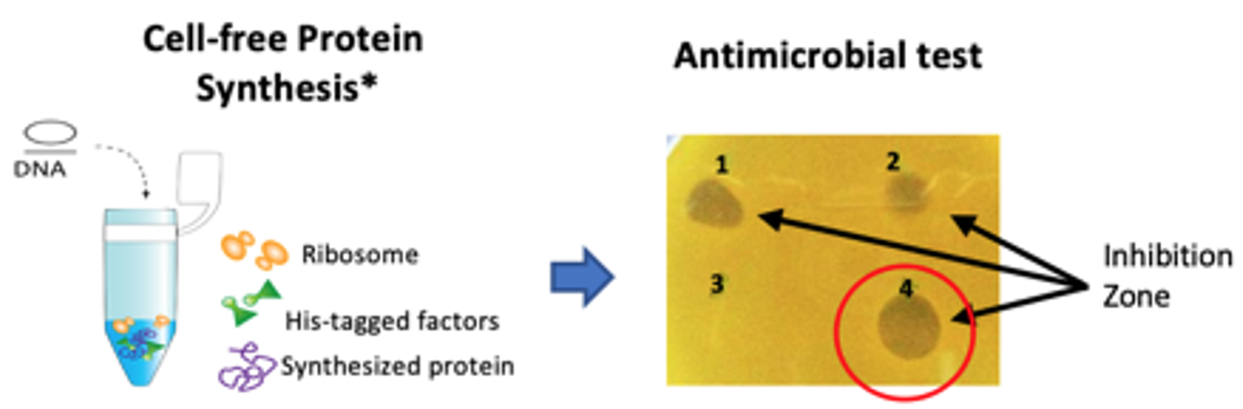
To explore the diversity of bacteriocins we have built a collection of synthetic genes in a standardized format
allowing rapid activity measurements of bacteriocins products.

Slide 29
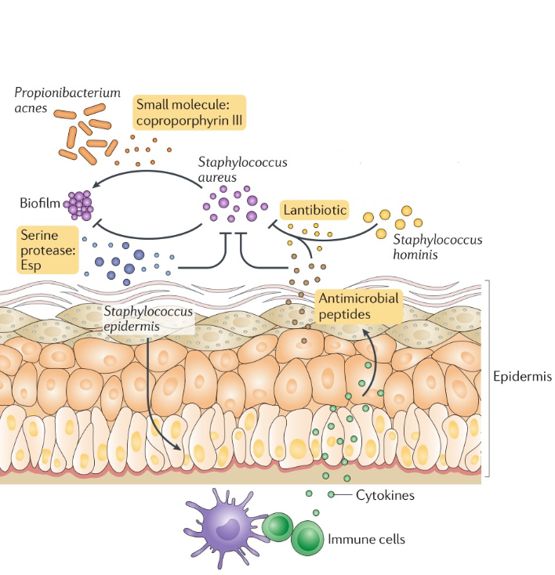
Example of a potential application

Slide 30
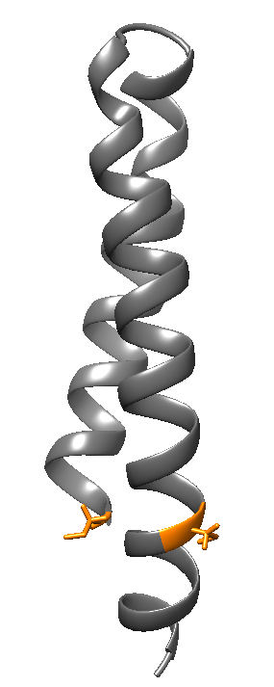







Mutant Library generation to determine
structure/function relationships
Type of mutations
Alanine scan
Deletion
Single or multiple amino acid mutation
(Charge variation)
(Disulfides bound)
Professor
Pascal Hols
Félix Jaumaux
Prof Cédric Govaerts and Prof Abel Garcia-Pino
30

Slide 31




Screening of the PARAGEN collection
Félix Jaumaux
Staphylococcus strain
Petri dish with a homogenous culture of a Staphylococcus strain
96 well plate containing chemically synthesized bacteriocins
Observation of inhibition halos
Professor
Pascal Hols
Professor Jacques Mahillon

Slide 32

Screening looking for bacteriocins active against S. aureus (7 strains tested)
Bacteriocins non active against S. epidermidis
(2 strains tested)
A; B; C

Slide 33




Publications
Other manuscripts in preparation

Slide 34
Take home message
Industries and the health sectors are looking for new ways to control microbial flora (microbiota)
Synthetic biology allows to apply biological functions at a new level
Bacteriocins are natural antimicrobial peptides (AMP) used by bacteria to protect their ecological niche
Syngulon has built PARAGEN a unique collection of synthetic bacteriocin genes (around 500 genes)
Via academic collaborations Syngulon is studying the mode of action of bacteriocins
Via different industrial/medical partnerships Syngulon is testing applications of bacteriocins

