Slide 1



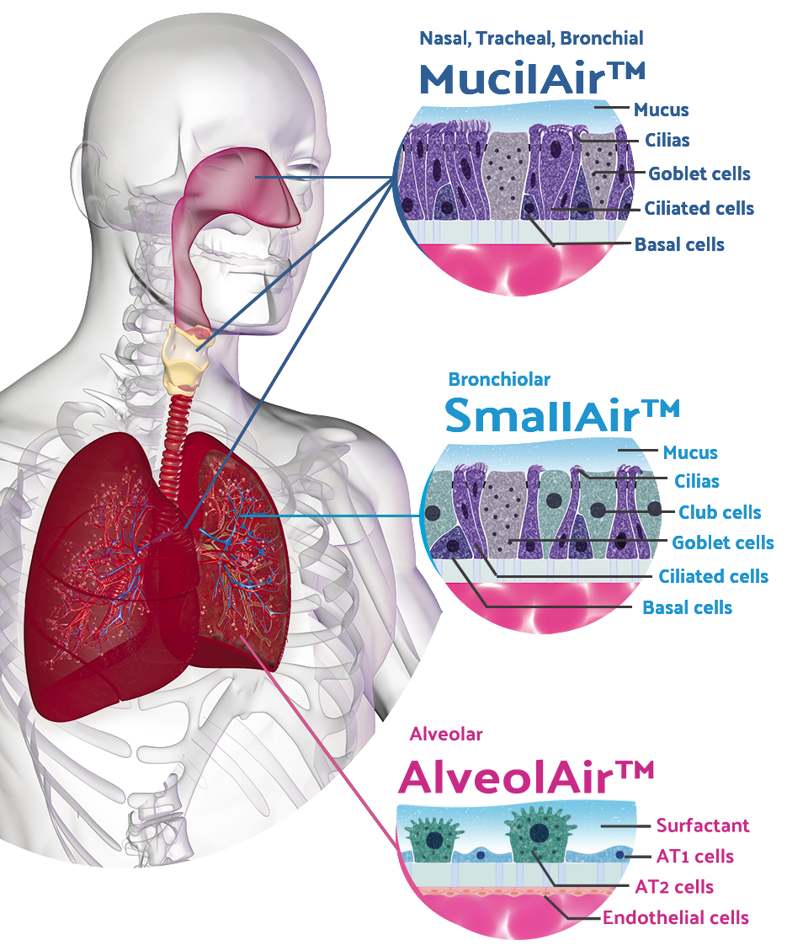

| 3D airway epithelia |
| Frozen primary cells |
| Testing services |
Archamps-France Geneva-Switzerland

Slide 2



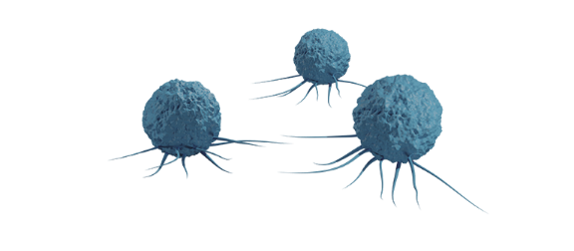



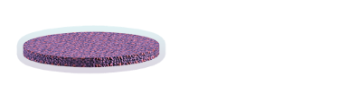
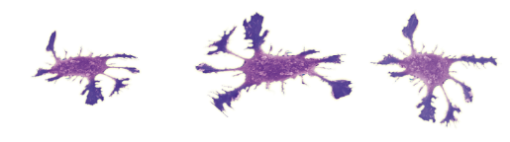

Novel advanced fully primary human immunocompetent models
  Primary lung Macrophages / Neutrophiles
  Fully primary airway tissues (Normal, COPD, Asthma, CF, Allergic…)
  MucilAir™
  SmallAir™
  AlveolAir™
  Fibroblasts or endothelial cells layer
  Dendritic cells
  Serum free and chemically defined culture medium
2

Slide 3
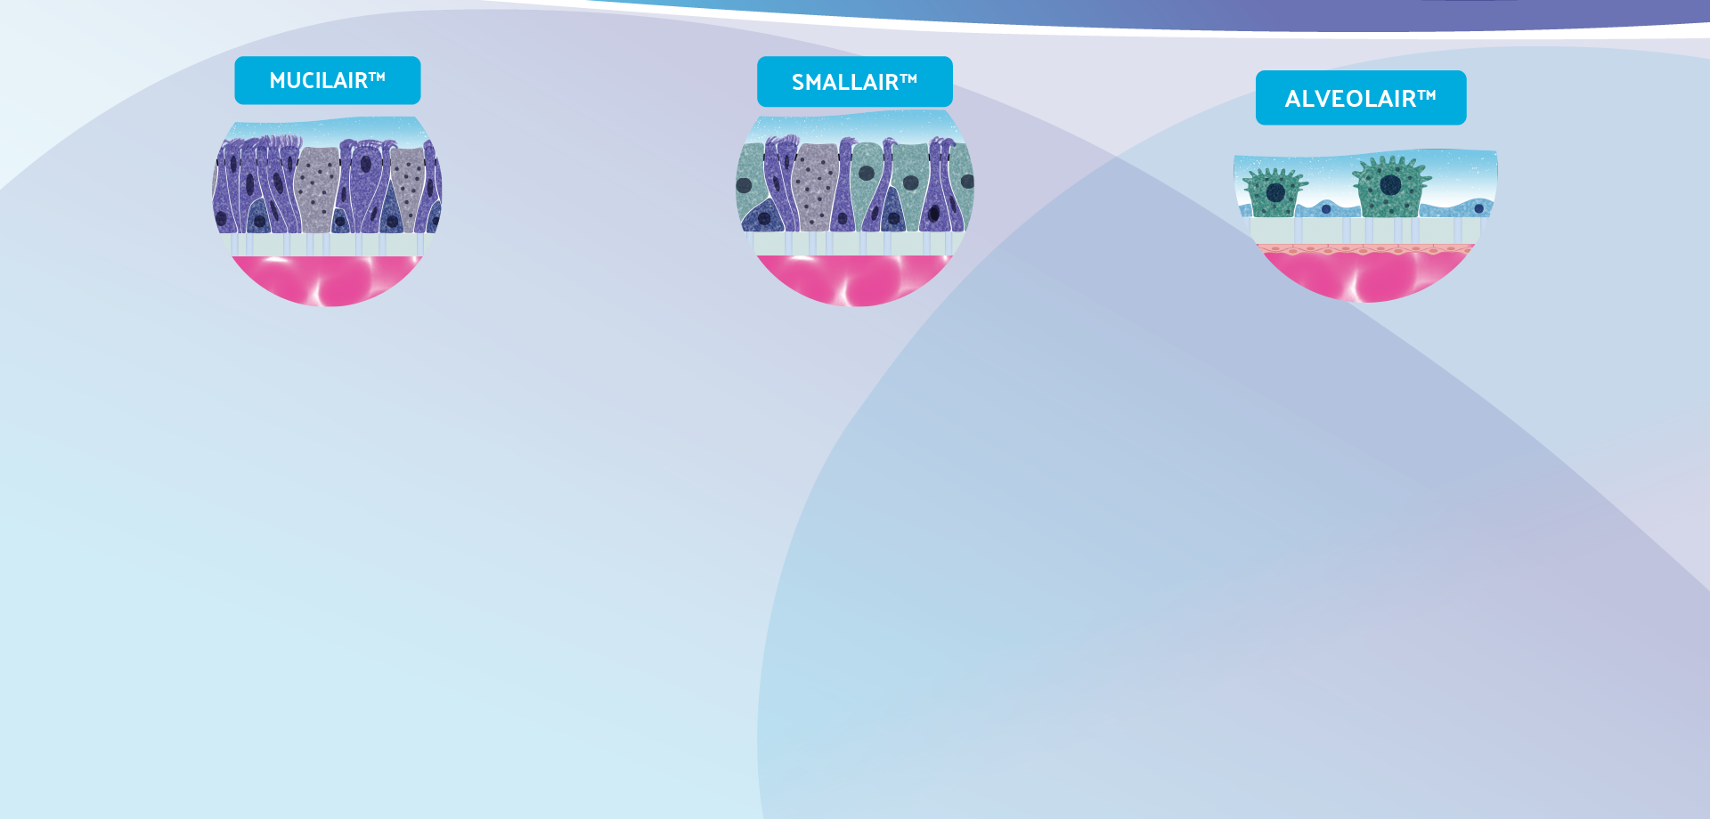
Epithelix Testing Services (CRO activity)
Nasal Dryness
Cilia beating frequency
Local cytotoxicity
Pro inflammatory profile
Asthma / COPD
Goblet cells hyperplasia
Activity of ion channels
Toxicity Testing
Local Toxicity
Pro inflammatory profile
Ciliopathic effects
Pulmonary fibrosis
Antifibrotic evaluation
Cystic Fibrosis
Mucociliary clearance
Activation, correction
and potentiation of CFTR
Local Toxicity
Pro inflammatory profile
Anti-inflammatory
Inhalation Delivery
Permeation of drugs or xenobiotics
PK/PD
Mucolytic Activity
Mucociliary clearance
Mucus secretion
Cilia Beating Frequency
Bacteria CFU
Local Toxicity
Cytokine release
Viral replication kinetic
Cytokine release
Ciliopathic effects
Bacterial Infection
Viral infection

